Slide 1
Brief overview of HIV among MSM in the EU/EEA
Teymur Noori, ECDC
22nd International AIDS Conference, Amsterdam 2018
Satellite event: European surveys and trainings to improve MSM community health (ESTICOM)
Monday 23 July 2018 – 17:00-19:00

Slide 2
Disclosure
Employed by the European Centre for Disease Prevention and Control
No potential conflict of interests

Slide 3
Outline
Epidemiological trends of HIV among MSM in Europe
Highlight how EMIS data complements ECDC monitoring data in the European region

Slide 4
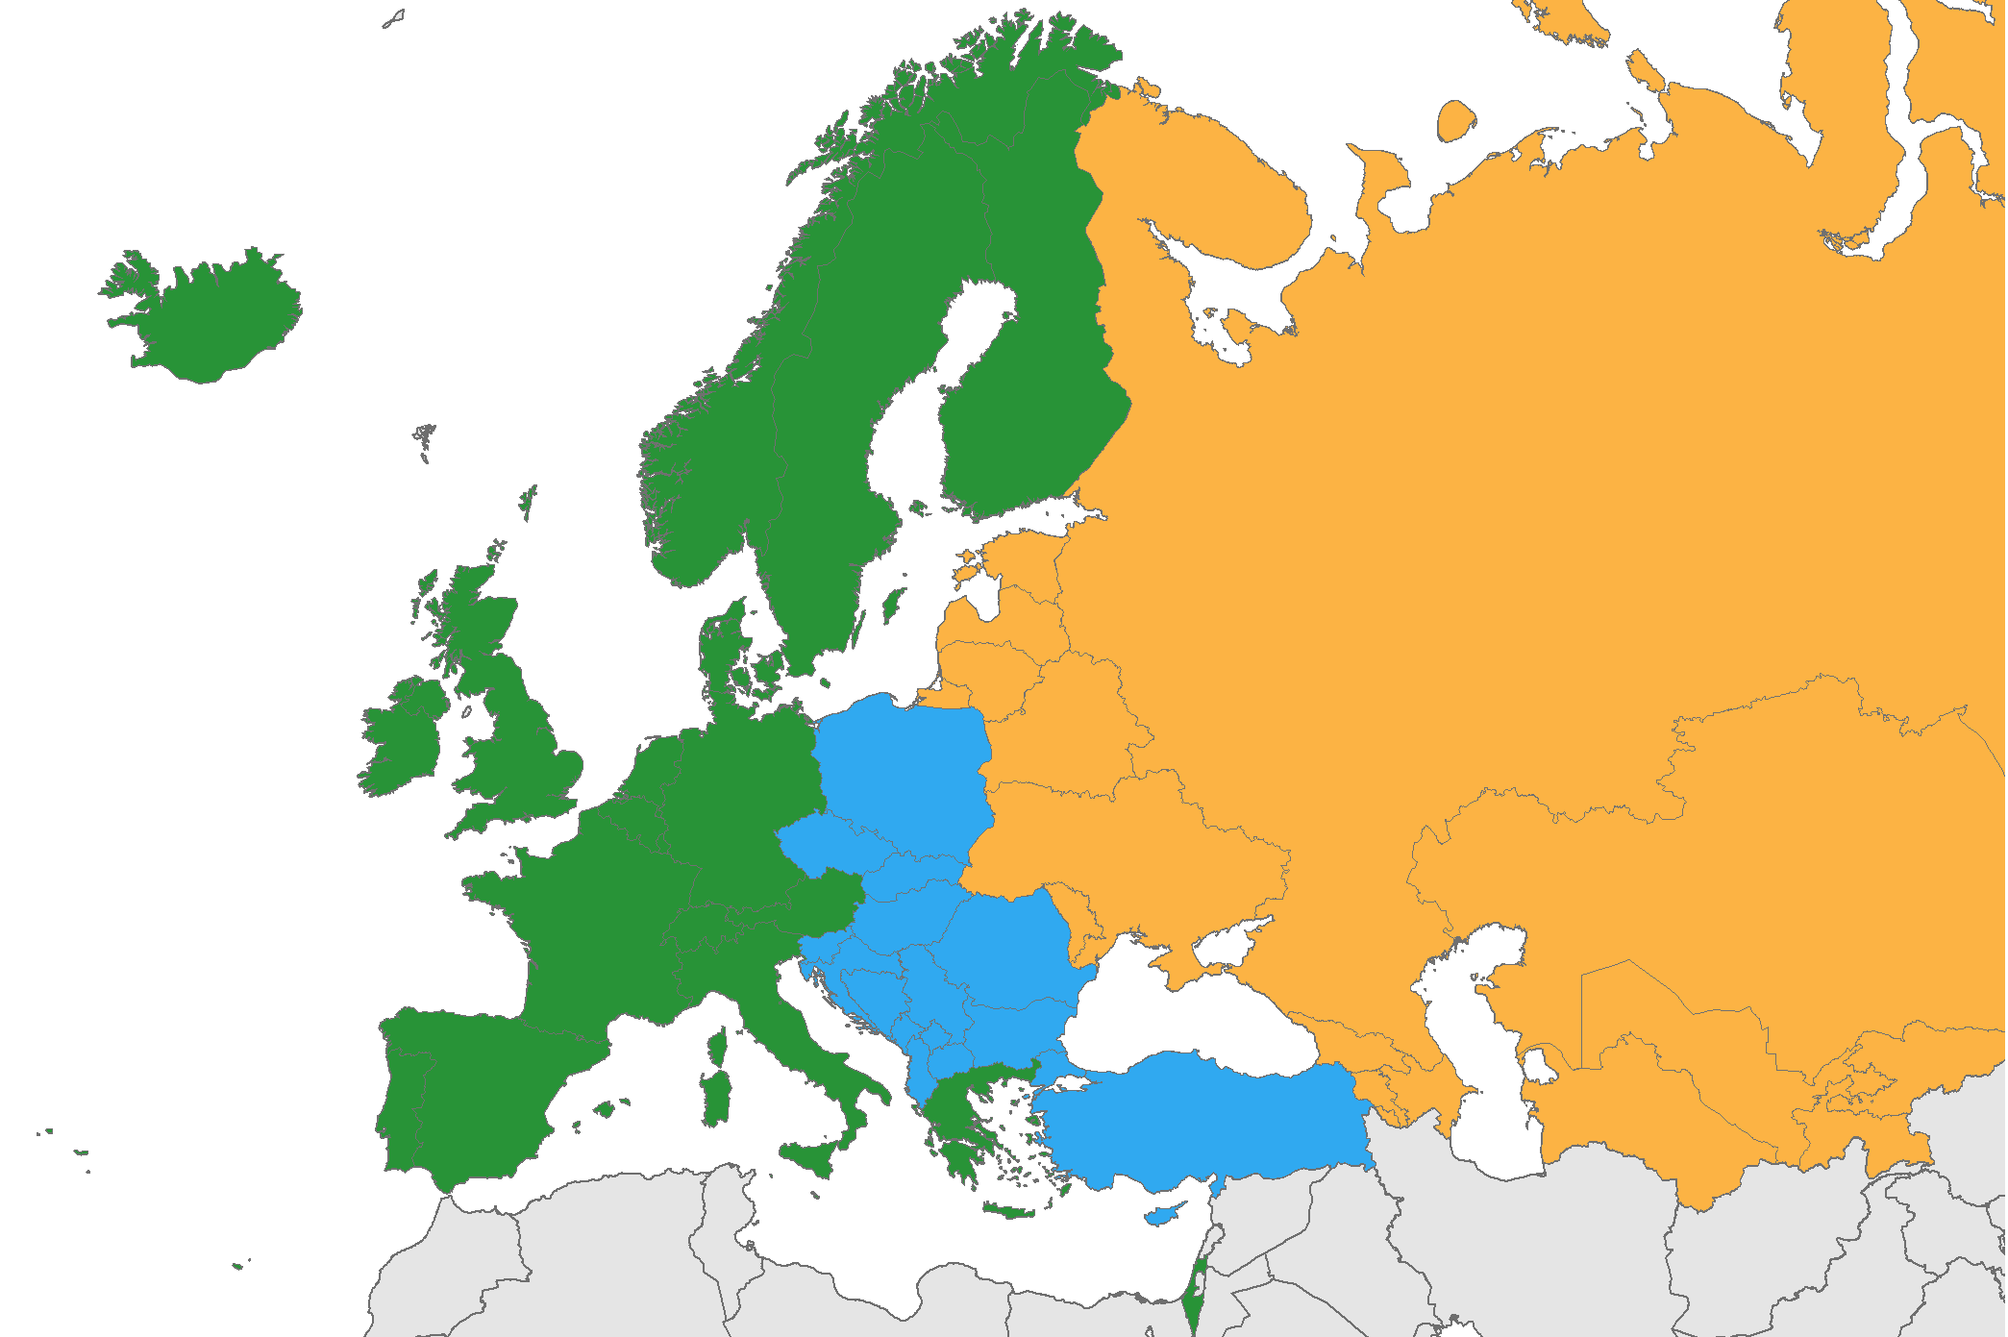
>160 000 persons were diagnosed with HIV in the WHO European Region in 2016
East
80%
≈ 128,000 cases
West
16%
≈ 26,000 cases
Centre
4%
≈ 5,800 cases
Source: ECDC/WHO (2017). HIV/AIDS Surveillance in Europe 2017– 2016 data

Slide 5
The number of MSM diagnosed with HIV is increasing in all three sub-regions of the WHO European Region
MSM = 4%
(2016)
800%
(2007-2016)
MSM = 41%
(2016)
11%
(2007-2016)
MSM = 30%
(2016)
189%
(2007-2016)
Source: ECDC/WHO (2017). HIV/AIDS Surveillance in Europe 2017– 2016 data

Slide 6
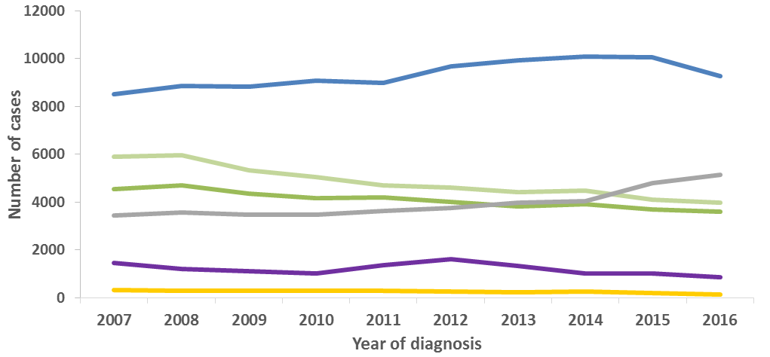
HIV diagnoses, by mode of transmission
2007-2016, EU/EEA
Sex between men
Other/
undetermined
Heterosexual (women)
Heterosexual
(men)
Injecting drug use
Mother-to-child transmission
Data is adjusted for reporting delay. Cases from Estonia and Poland excluded due to incomplete reporting on transmission mode during the period; cases from Italy and Spain excluded due to increasing national coverage over the period.
Source: ECDC/WHO (2017). HIV/AIDS Surveillance in Europe 2017– 2016 data

Slide 7
MSM account for 51% of all diagnosed cases of HIV with known mode of transmission, EU/EEA, 2016
MSM
If we are going to achieve HIV epidemic control in the EU/EEA, we must rely on good behavioural data among MSM
Other
Source: ECDC/WHO (2015). HIV/AIDS Surveillance in Europe, 2014
Source: ECDC/WHO (2017). HIV/AIDS Surveillance in Europe 2017– 2016 data

Slide 8
MSM are disproportionately at risk for and affected by HIV, STI and viral hepatitis
Proportion of new diagnoses attributed to sex between men, EU/EEA, 2016
100%
100%
75%
51%
52%
20%
13%
14%
12%
Source: ECDC, Sexually transmitted infections in Europe, 2016; Hepatitis B and C in Europe, 2016;
ECDC/WHO HIV Surveillance in Europe 2016 data, 2017
Notes:
In addition to HIV, where MSM accounted for 53% of new diagnoses made in 2015 in EU countries, MSM are also disproportionately affected by other sexually transmitted infections, including hepatitis B and C; gonorrhoea; syphilis; and LGV

Slide 9
How does EMIS data complement Dublin Declaration monitoring in the European region?

Slide 10
Availability of data along the various stages of the continuum of care, MSM
ECDC gets patchy data on the continuum of care among MSM
EMIS collects data on self-reported continuum of care among MSM from 43 countries
Very valuable to triangulate with officially reported data from countries
Source: ECDC. Dublin Declaration monitoring 2018; validated unpublished data.

Slide 11
Progress toward achieving the first 90, MSM: Target 1: 90% of all MSMLHIV who know their status (n=13)
Target reached
Below target
Global target 90%
Average 86%
Source: ECDC. Dublin Declaration monitoring 2018; validated unpublished data.

Slide 12
Progress toward achieving the second 90, MSM: Target 2: 90% of those diagnosed on ART (n=16)
Target reached
Below target
Global target 90%
Average 90%
Source: ECDC. Dublin Declaration monitoring 2018; validated unpublished data.

Slide 13
Progress toward achieving the third 90, MSM: Target 3: 90% of those on ART virally suppressed (n=15)
Target reached
Below target
Average 96%
Global target 90%
Source: ECDC. Dublin Declaration monitoring 2018; validated unpublished data.

Slide 14
Progress toward achieving the 90-90-90, MSM: Overall target: 73% of all MSMLHIV virally suppressed (n=10)
Target reached
Below target
Global target 73%
Source: ECDC. Dublin Declaration monitoring 2018; validated unpublished data.

Slide 15
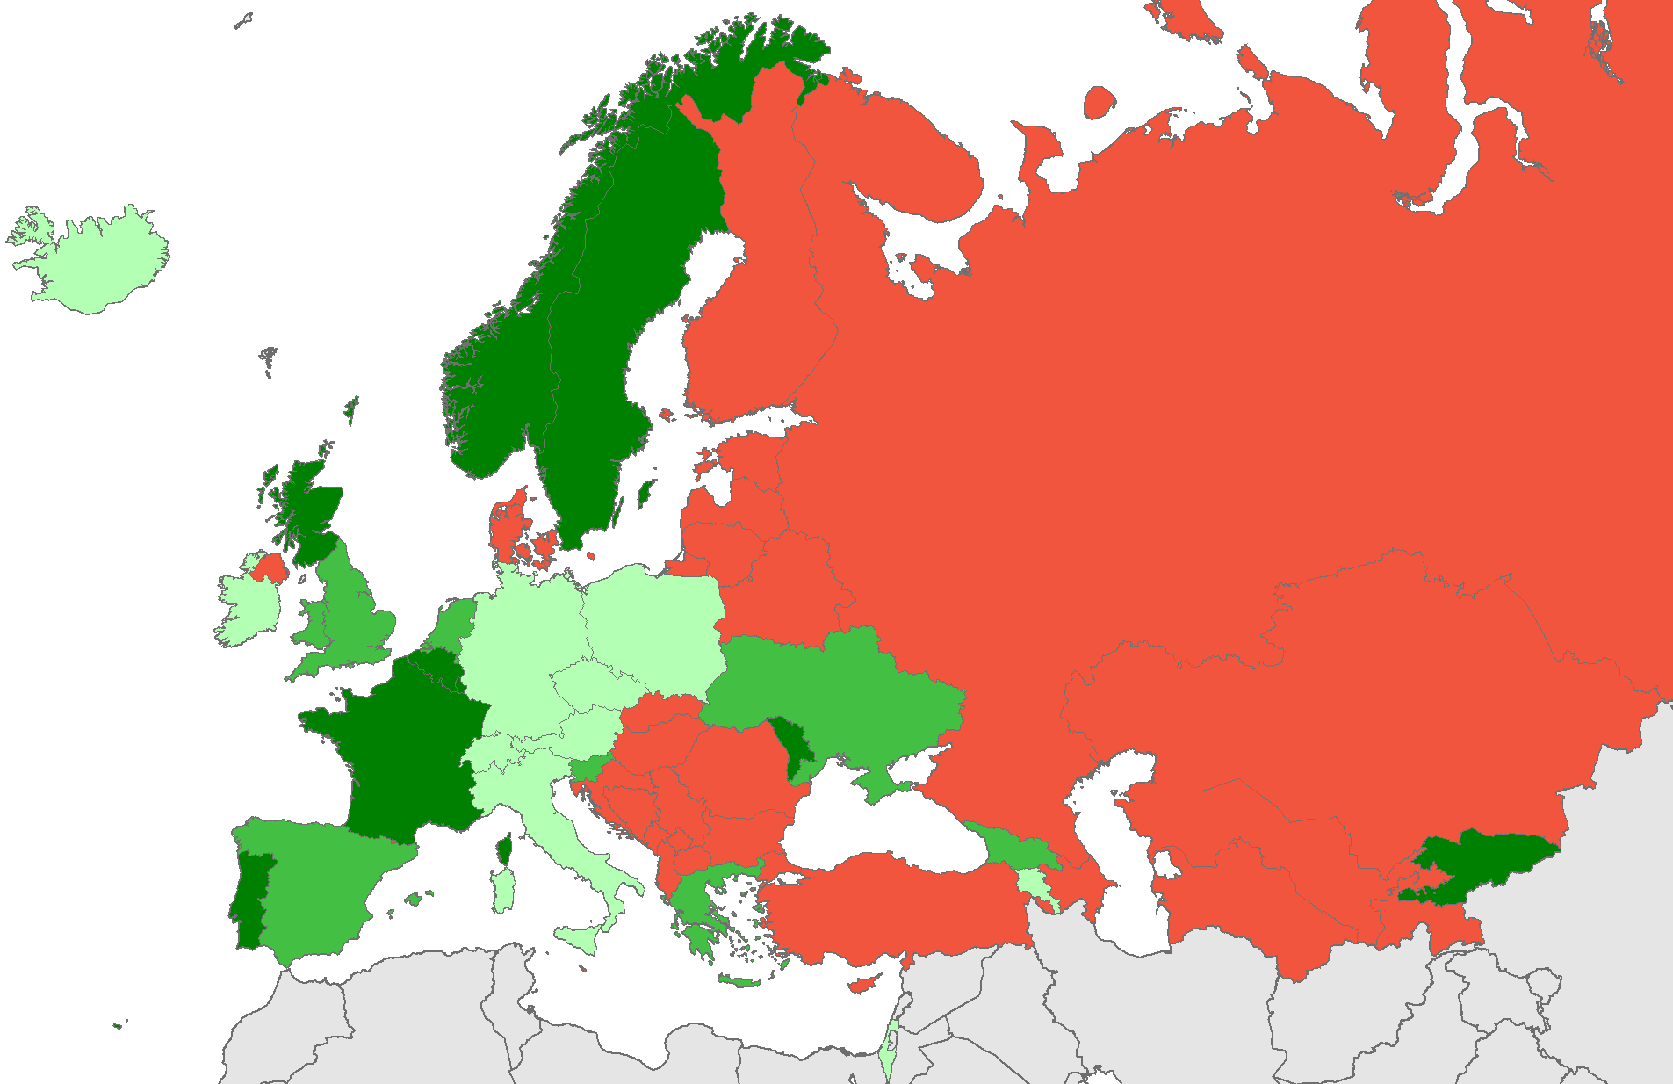
Status of formal PrEP implementation in Europe July, 2018
ECDC collects data on PrEP policies and on PrEP uptake
Only countries with formal PrEP programmes report on PrEP use
EMIS provides data on PrEP use (formal/informal) from 43 countries
Source: ECDC. Dublin Declaration monitoring 2018; validated unpublished data.

Slide 16
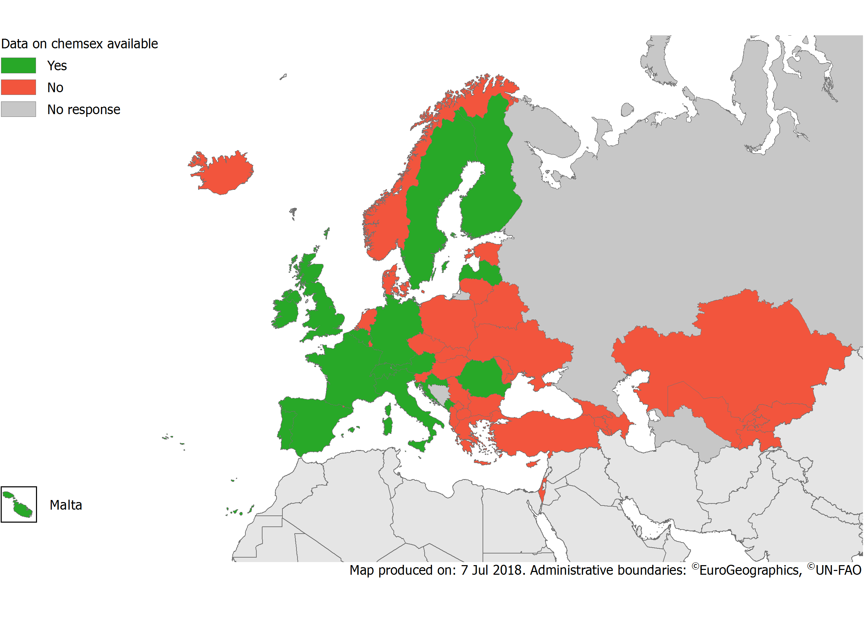
Are data available on Chemsex among MSM in your country? 2018
ECDC asks if data on Chemsex is available and gets non-comparable data from 15 countries
EMIS provides comparable data on the use of Chems in sexualised contexts from 43 countries
Source: ECDC. Dublin Declaration monitoring 2018; validated unpublished data.

Slide 17
EMIS reporting countries 2018
43 countries are able to supply EMIS data on 22 indicators as part of their commitment to report to international agencies (ECDC, UNAIDS, WHO)

Slide 18
Conclusions
MSM are disproportionally affected by STIs/HIV in the EU/EEA
For the first time in a decade, we are seeing declines in HIV incidence in some cities/countries across Europe
If we are going to achieve HIV epidemic control in the EU/EEA, we must rely on good behavioural data among MSM
EMIS provides a richness of data to countries who are able to tailor and target effective responses to MSM communities
Without EMIS data, responding effectively to HIV in Europe would be significantly more challenging

Slide 19
Thank you
teymur.noori@ecdc.europa.eu

